Slide 1

Calories Burnt Prediction using Machine Learning
Team members:
Swetha Saravanan
Ranjith Kumar P
Vimal Nisanth V
Nandha Kumar S
Project Guide:
Dr. P. Ramya(Teaching Fellow)

Slide 2
Table of Contents
Introduction
Abstract
Problem Statement
Existing system
Proposed system
Data Flow diagram
Algorithms
Experimental Results
Conclusion
References

Slide 3
Introduction
In this fast and busy schedule life, people are not giving importance to the quality of food they are eating. They tend to neglect their eating pattern and habits. The fast-food consumption rate is alarmingly high and this consequently has led to the intake of unhealthy food. This leads to various health issues such as obesity, diabetes, an increase in blood pressure etc. Hence it has become very essential for people to have a good balanced nutritional healthy diet. There are many applications which are booming to help people so that they can have control over their diet and hence can reduce weight or they can help them to keep them fit and healthy.

Slide 4
This project focuses on the calories burned in accordance with the duration provided and heart rate during the exercise period. It introduces the topic of linear regression and its predicting capability with the effectiveness from the data provided. This research helps in providing the benefits of a machine learning algorithm over predicting the calories burned.

Slide 5
Objective
This project is to predict the calorie burned during the workout of different people and compare the two algorithms in machine learning by looking through the data sets. The dataset used in this study has 7 features, one target variable, and 15000 instances. We are using this data sets to train a dataset and find out the accurate algorithms and its mean absolute error and find the best model.

Slide 6
Machine Learning
Machine learning is an application of artificial intelligence that involves algorithms and data that automatically analyse and make decision by itself without human intervention.
The difference between normal computer software and machine learning is that a human developer hasn’t given codes that instructs the system how to react to situation, instead it is being trained by a large number of data.

Slide 7
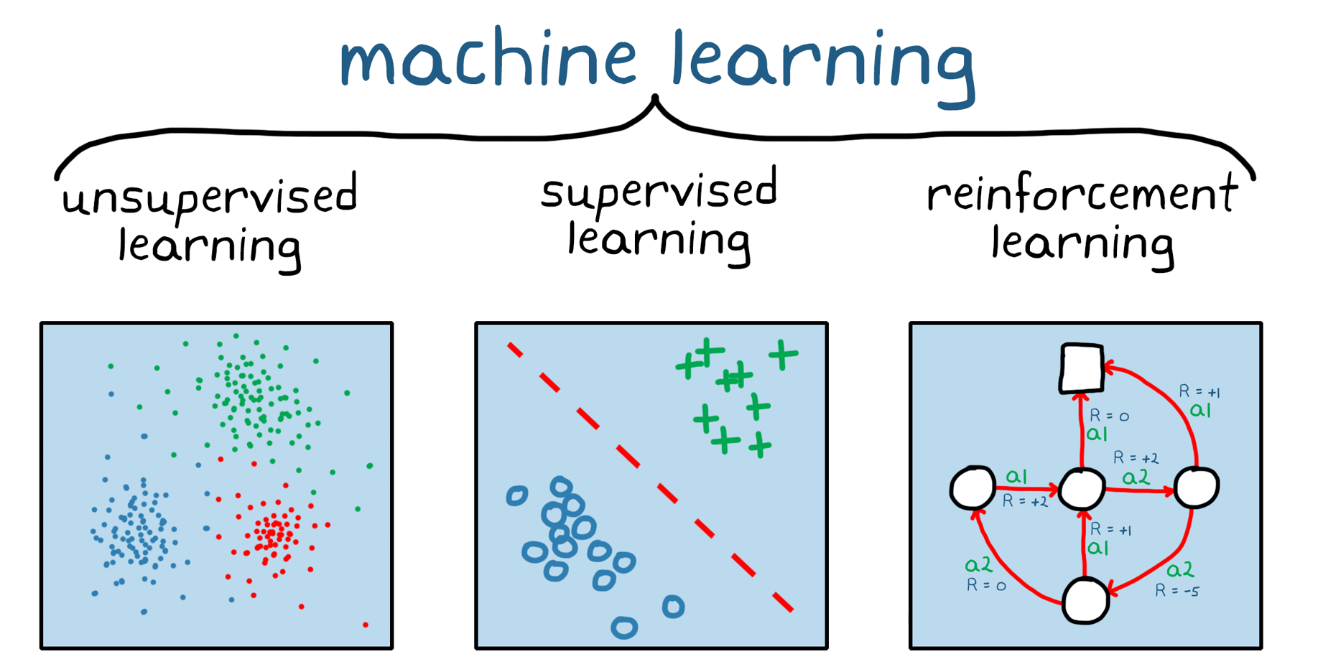
Types of Machine Learning
There are three types of Machine Learning
Supervised learning
Unsupervised learning
Reinforcement learning

Slide 8
Supervised learning
Supervised learning is a technique where the program is given labelled input data and the expected output data. It gets the data from training data containing sets of examples. They generate two kinds of results
Classification: They notify the class of the data it is presented with.
Regression: they expect the product to produce a numerical value.

Slide 9
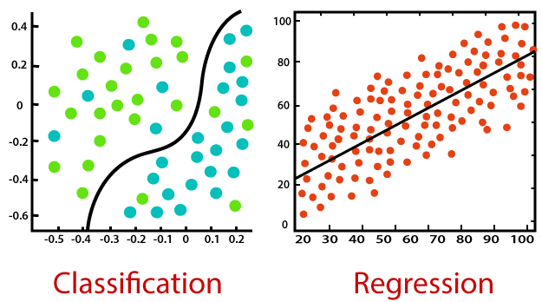

Slide 10
Unsupervised learning
Unsupervised learning refers to the use of artificial intelligence (AI) algorithms to identify patterns in data sets containing data points that are neither classified nor labelled.
The algorithms are thus allowed to classify, label and/or group the data points contained within the data sets without having any external guidance in performing that task.

Slide 11
Reinforcement learning
Reinforcement learning is an area of Machine Learning. It is about taking suitable action to maximize reward in a particular situation. It is employed by various software and machines to find the best possible behaviour or path it should take in a specific situation. Reinforcement learning differs from supervised learning in a way that in supervised learning the training data has the answer key with it so the model is trained with the correct answer itself whereas in reinforcement learning, there is no answer but the reinforcement agent decides what to do to perform the given task. In the absence of a training dataset, it is bound to learn from its experience.

Slide 12
Abstract
As we know that running is the effective workout for most calories burnt per hour. Stationary bicycling, running, and swimming are fabulous choices as well.
Forecasting the workout burnt calories still remains an open challenge as the changes in the environmental calamity and body health.
The machine learning strategies can predict the burnt out calories for the course of exercise done by a body.
With this background, we have utilized Exercise dataset extracted from Kaggle Machine Learning repository for predicting the workout burnt calories.

Slide 13
The forecasting of burnt calories rate are achieved using Linear Regressor, XGB Regressor and Random Forest Regressor algorithms. The execution is done using python language under google colab.
Experimental results shows that the Linear Regressor, XGB Regressor and Random Forest Regressor tends to retain 96%, 99.6%, 99.9%.
The mean absolute error value that is getting in Linear Regressor, XGB Regressor and Random Forest Regressor is 8.385, 2.715, 1.700.
The error value is very less in Random Forest Regressor. Therefore we can conclude that the best model for the calorie burn prediction is Random Forest Regressor.

Slide 14
PROBLEM STATEMENT
The variety of energy burned each day is immediately connected to weight loss, weight gain, or weight maintenance. To shed pounds, a person ought to burn greater calories than they take in, developing a calorie deficit. but, to do that they want to recognize what number of calories they burn each day. Most people think about calories as most effective having to do with food and weight reduction Calorie, a unit of energy or heat variously defined. Calorie may be defined as the amount of energy that is vital to increase 1 gram(g)of water by means of 1°C.This measurement can be carried out to lots of different strength releasing mechanisms outdoor of the human body.

Slide 15
Therefore, the goal of our project is to apply algorithms of machine learning over large existing data sets to effectively predict the calories burnt while doing exercise and to find the best algorithm that provides good accuracy.

Slide 16
EXISTING SYSTEM
In the Existing system they met with a conclusion that the XGB Regressor has more accurate results than the Linear regression model. Mean absolute error imply absolute error ought to be as low as viable. it is not anything but the difference between the actual and predicted values through the models. The mean absolute error value that is getting in XGB Regressor is 2.71 which is a good value. The error value is very less. Therefore they conclude that the XGBoost Regressor is better than Linear regression.

Slide 17
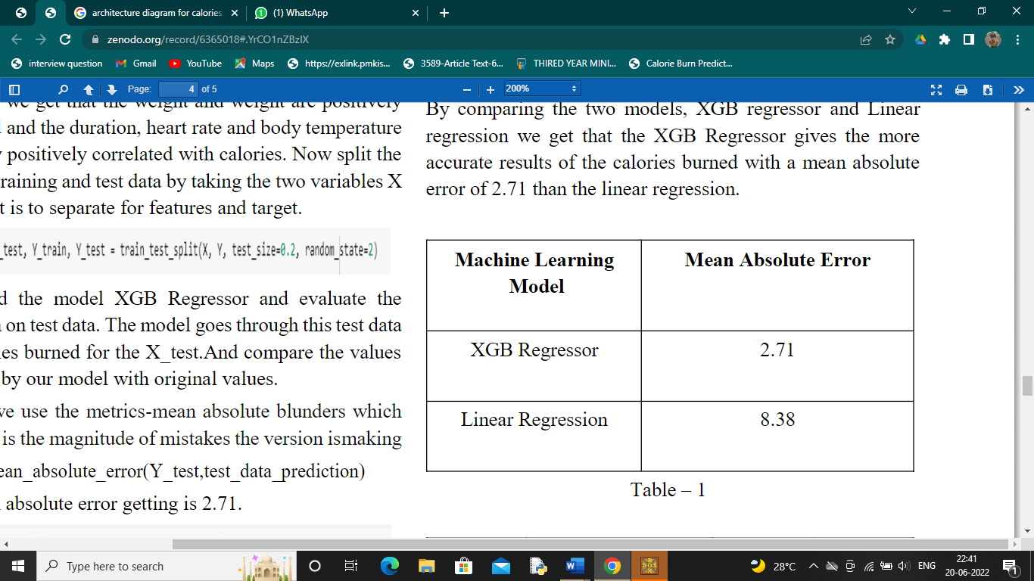

Slide 18
PROPOSED SYSTEM
This paper is all about the collection of appropriate set to teach our machine learning models in order that it will find out what is the amount of calories that the individual goes to burn. Before feeding procedure the statistics via records pre-processing need to be done. After that data analysis is carry out where we use some visualization techniques to arrange the data in plots and graphs. Afterwards divide the data set into training and test set. Here we use Random Forest Regressor, XGBoost regressor and linear regression as machine learning models for comparison and then evaluate this models. The tool used is Google Colaboratory or Google Colab is a web based tool and a cloud-based service.

Slide 19
Data flow diagram
Dataset
(
Exercise,
)
Calories
Data Pre
-
processing
Linear
XGBoost
RandomForest
Regressor
Regressor
Regressor
Comparison
(
Accuracy
)

Slide 20
Modules and Descriptions
Dataset:
The Exercise dataset with 8 independent variables and 1 dependent variable has been used for implementation. The two csv files are uploaded in colab which is used for processing. We use data frames for analysis and processing. It obtain some statistical measures about the data. The datasets that are used in this project are Exercise and Calories.

Slide 21
Data Pre-Processing:
Two datasets are Concatenated initially. And then the number of rows and columns are checked in the concatenated dataset. After this, missing values are listed in order to find the null values in a dataset. And the data is visualized according to age, height, weight. Then we study the correlation the various records and there are two types of correlation, positive and negative correlation.

Slide 22
Evaluation:
Model evaluation is the process of using different evaluation metrics to understand a machine learning model’s performance, as well as its strengths and weaknesses. Model evaluation is important to assess the efficacy of a model during initial research phases, and it also plays a role in model monitoring.
Now load the model Linear Regression and evaluate the prediction in test data. Similarly evaluate the prediction using XGB Regressor and Random Forest Regressor. Performance analysis is done using metrics like Mean Absolute Error.

Slide 23
Comparison:
From the performance analysis compare the error values and the accuracy of the three models to find the best algorithm.

Slide 24
Algorithms
Algorithms used:
Linear Regressor
XGB Regressor
Random Forest Regressor

Slide 25
Linear Regression:
Linear regression is one of the easiest and most popular Machine Learning algorithms. It is a statistical method that is used for predictive analysis. Linear regression makes predictions for continuous/real or numeric variables such as sales, salary, age, product price, etc.
Linear regression algorithm shows a linear relationship between a dependent (y) and one or more independent (y) variables, hence called as linear regression. Since linear regression shows the linear relationship, which means it finds how the value of the dependent variable is changing according to the value of the independent variable.

Slide 26
XGBoost Regressor
XGBoost Regressor is a decision-tree-based ensemble Machine Learning algorithm that uses a gradient boosting framework.
Extreme Gradient Boosting (XGBoost) is an open-source library that provides an efficient and effective implementation of the gradient boosting algorithm.
Regression predictive modeling problems involve predicting a numerical value such as a dollar amount or a height. XGBoost can be used directly for regression predictive modeling.

Slide 27
Random Forest Regressor
Random Forest is an ensemble technique capable of performing both regression and classification tasks with the use of multiple decision trees and a technique called Bootstrap and Aggregation, commonly known as bagging. The basic idea behind this is to combine multiple decision trees in determining the final output rather than relying on individual decision trees.
Random Forest has multiple decision trees as base learning models. We randomly perform row sampling and feature sampling from the dataset forming sample datasets for every model. This part is called Bootstrap.

Slide 28
Software Requirement
Google Colab:
Colab allows anybody to write and execute arbitrary python code through the browser, and is especially well suited to machine learning, data analysis and education.
Anyone can use Google Colab to write and run arbitrary Python code in the browser. However, it is still a relatively closed environment, as machine learning practitioners can only run the python package already pre-added on the Colab.

Slide 29
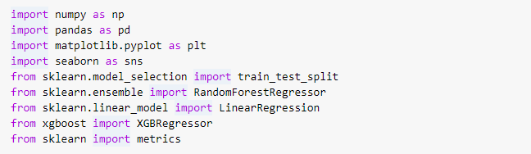
Experimental Results

Slide 30
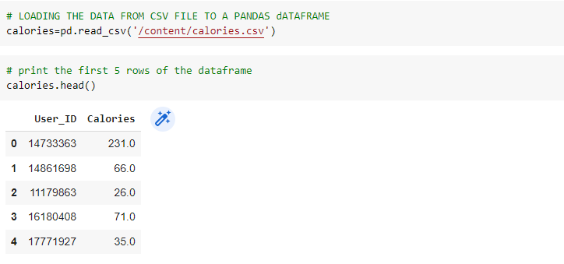

Slide 31
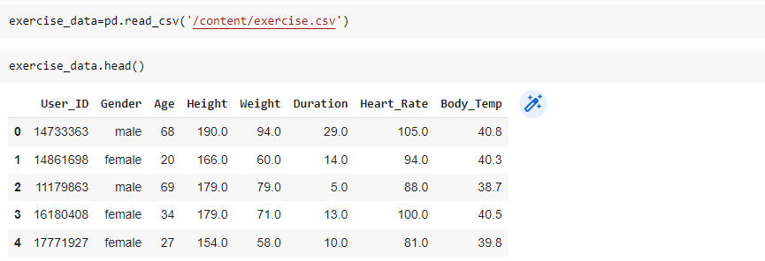

Slide 32
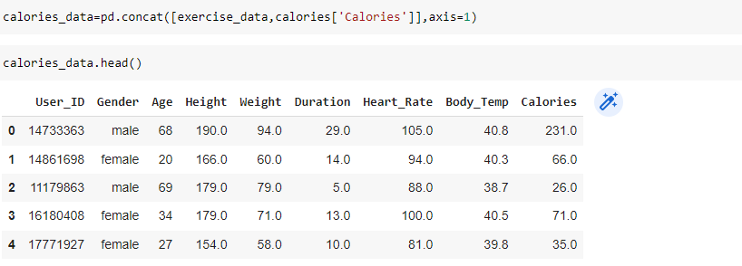

Slide 33
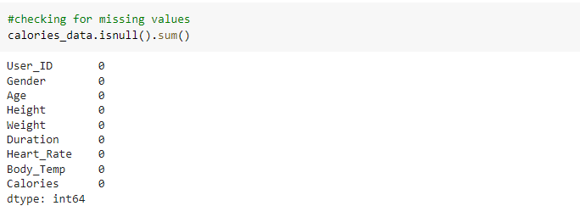

Slide 34
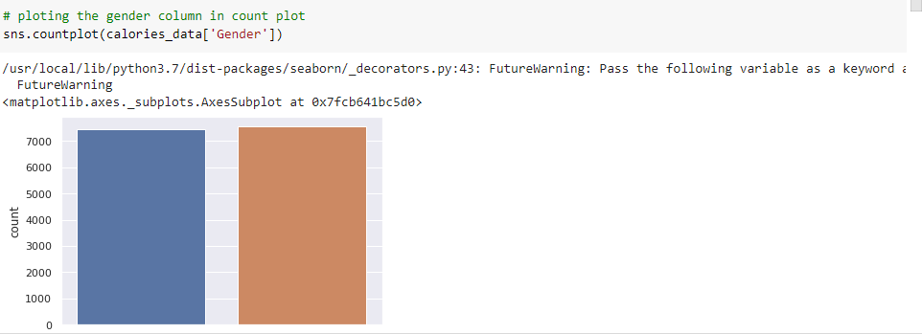

Slide 35
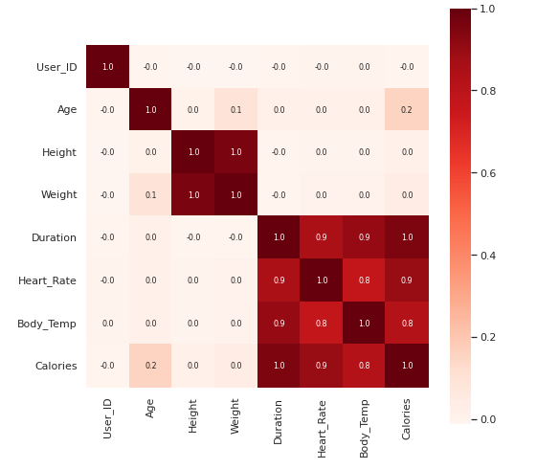

Slide 36
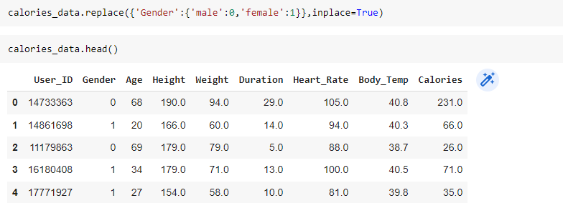

Slide 37
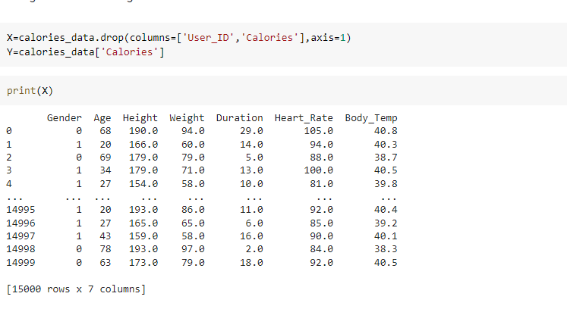

Slide 38
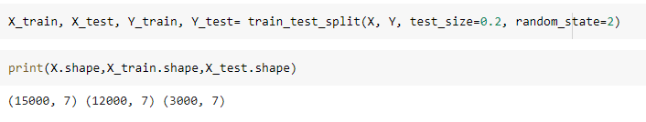

Slide 39
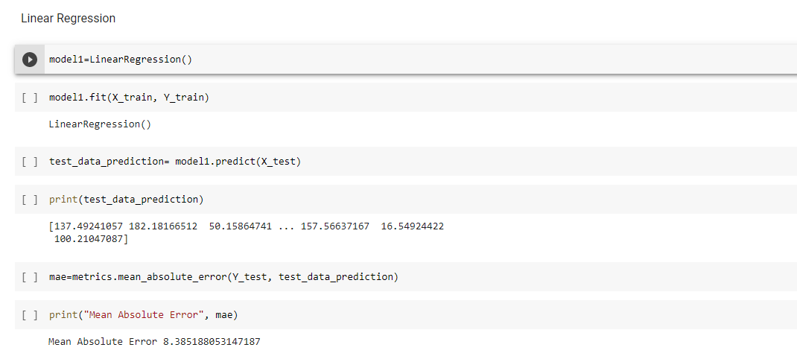

Slide 40
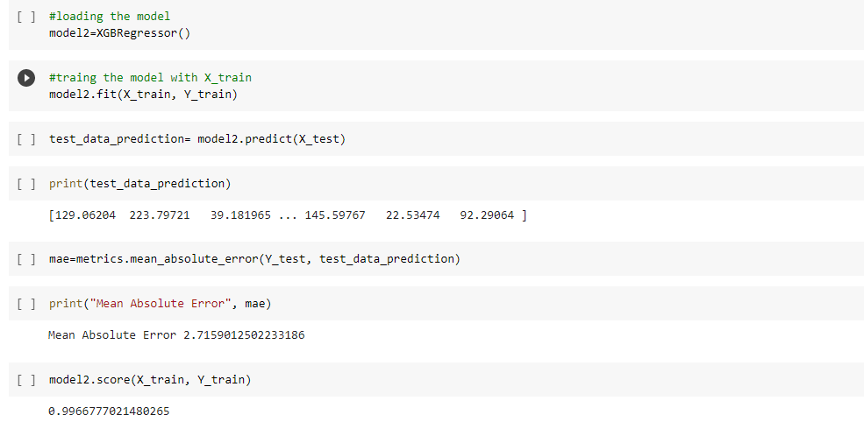

Slide 41
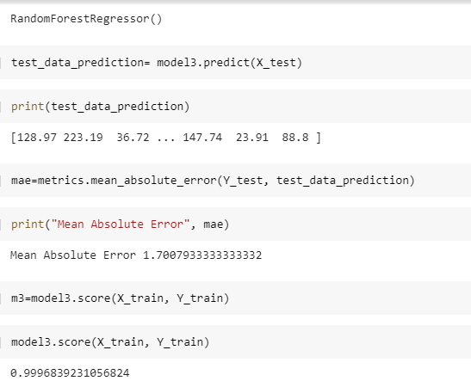

Slide 42
Algorithms accuracy
Linear Regressor:
Accuracy:96%
XGB Regressor:
Accuracy:99.6%
Random Forest Regressor:
Accuracy:99.9%

Slide 43
Comparison

Slide 44
Conclusion
From the analysis we met with a conclusion that the Random Forest Regressor has more accurate results than the Linear regression model and XGB regressor. Mean absolute error imply absolute error ought to be as low as viable. It is not anything but the difference between the actual and predicted values through the models. The mean absolute error value that is getting in Random Forest Regressor is 1.700 which is a good value. The error value is very less. Therefore, we can conclude that the best model for the calories burn prediction is Random Forest Regressor.

Slide 45
References
Herman Pontzer, “Burn: New Research Blows the Lid Off How We Really Burn Calories, Lose Weight, and Stay Healthy,” April 2015.
Ingmar, “Forecasting Workout Burnt Calories Using Machine Learning,” in Qatar Computing Research Institute, January 2016.
R.N. Dickerson, J. J. Patel, and C. J. McClain, “Protein and Calorie Requirements Associated With the Presence of Obesity. in Nutr Clin Pract. vol. 32, no. 1, 2017.
Trevon D. Logan NBER, “The Transformation of Hunger: The Demand for Calories Past and Present,” in National Bureau of Economic Research, Working Paper No. 11754, November 2005.
Manal Chokr, and Shady Elbassuoni, “Calories prediction from food images,” in Innovative Applications of Artificial Intelligence, 2017.

